Slide 1
THE KANSAS DEPARTMENT OF AGRICULTURE KACD WRAPS
Year End Report
Cathy Thompson
Division of Conservation
May 15, 2025
Notes:
Please let us know if you would like to change this photo to fit your presentation.
We can easily do that.

Slide 2
KACD will require that all County’s that receive an allocation will submit a Quarterly Report to Amanda Scott. The report will give the status of each contract that is approved or paid. If a contract cancels you will need to let KACD know so that the funds can be allocated to the next contract. The next few slides will show how to run the Year End Report and how to download into an Excel Spreadsheet.

Slide 3
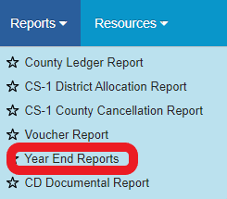
The Year End Report can be found under Reports:
Click the Search Criteria:

Slide 4
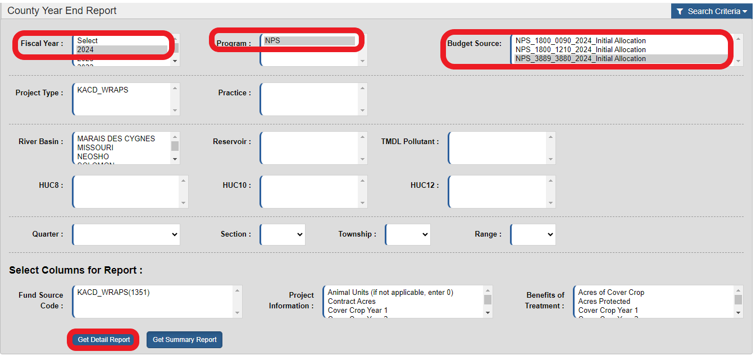
Select the following Search Criteria – Fiscal Year - 2025, Program – NPS and the Budget Source – NPS_3880_3889_2025_Initial Allocation and click the Get Detail Report:

Slide 5
When the Report has run click on the Search Criteria to collapse the Search information:
The Report will open in Detail Report and you can download the Report by clicking on the three blue lines on the right hand side of the report:

Slide 6
Select Export all data as a csv:
The download will appear in the upper right-hand corner of your browser and you can think open the spreadsheet by clicking on the document:
The document will open in Excel but will be a csv file you will need to save the Report as an Excel Spreadsheet so that you can then e-mail the Report to KACD.

Slide 7
THANK YOU
Cathy Thompson
Program Consultant cathy.Thompson@ks.gov

